Slide 1
Maven, JUnit

Slide 2
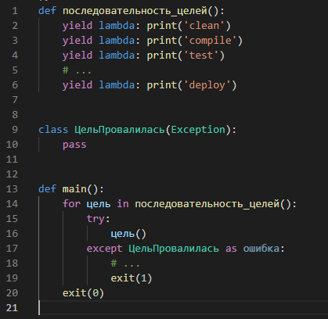
Почти Maven, но на Python
2004

Slide 3
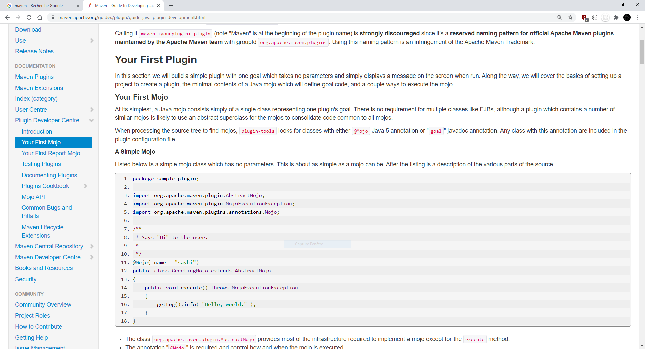
Maven is - at its heart - a plugin execution framework; all work is done by plugins.

Slide 4

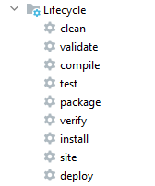

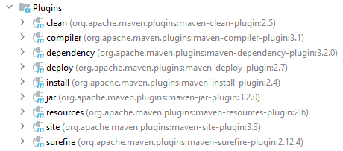
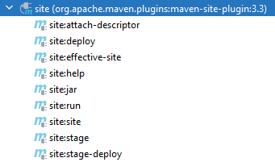
Maven UNBOXING

Slide 5
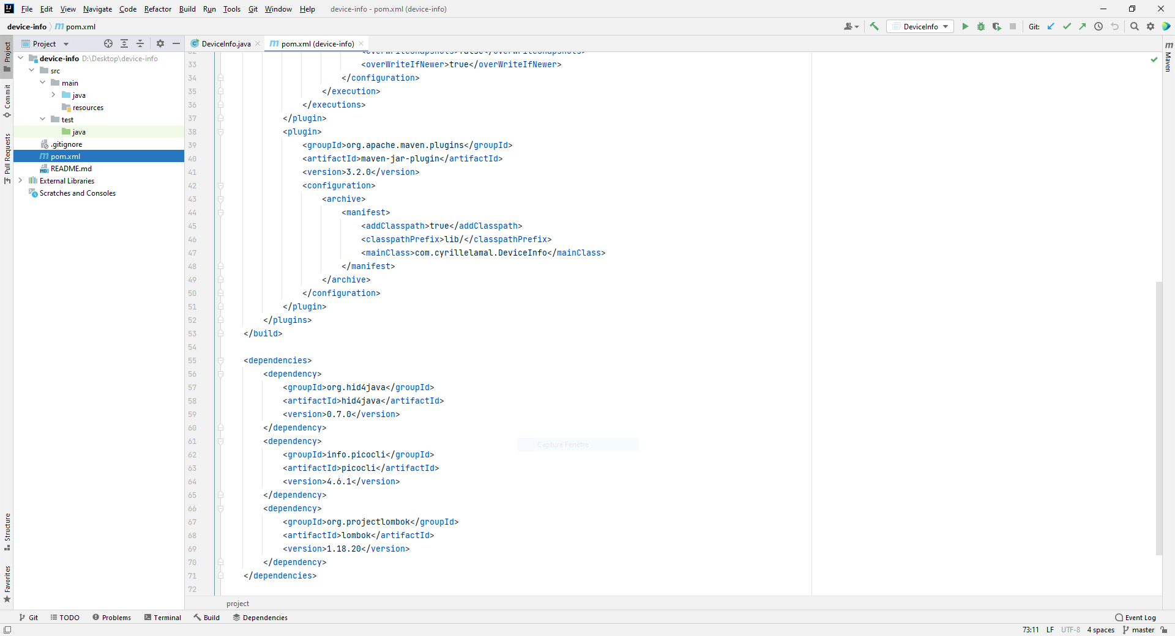
Maven. Структура проекта

Slide 6
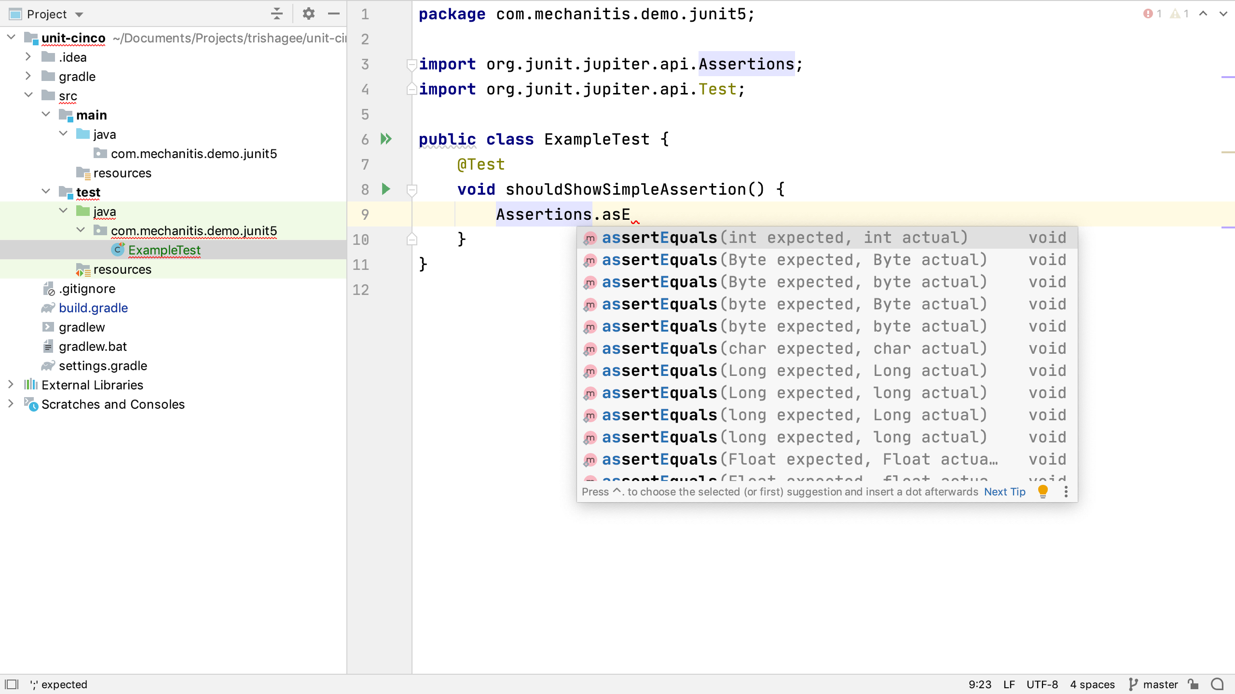
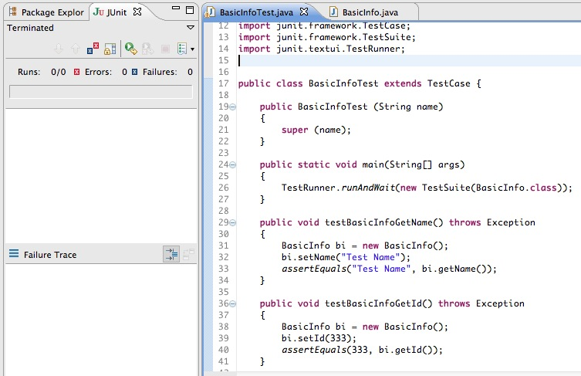
JUnit
Legacy (наследование)
Actual (AOP)

Slide 7
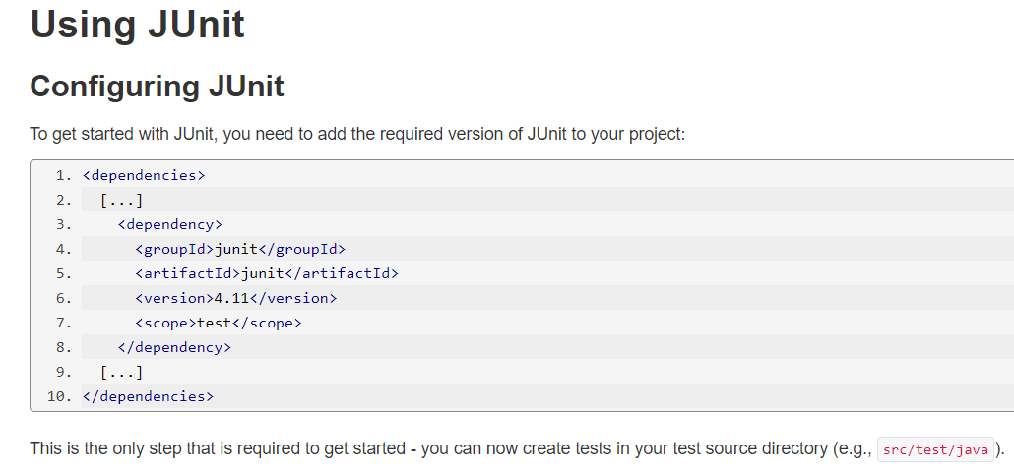
Maven + JUnit

